Slide 1
Student- Centered Learning
Olga Shkrabachenko
Kharkiv sanatorium complex #13

Slide 2
‘Placing learners at the heart of the learning process and meeting their needs, is taken to a progressive step in which learner-centered approaches mean that persons are able to learn what is relevant for them in ways that are appropriate. Waste in human and educational resources is reduced as it suggested learners no longer have to learn what they already know or can do, nor what they are uninterested in’. (Edwards R).

Slide 3
Student-Centered Learning
flexible learning
experiential learning
self-directed learning

Slide 4
what how why

Slide 5
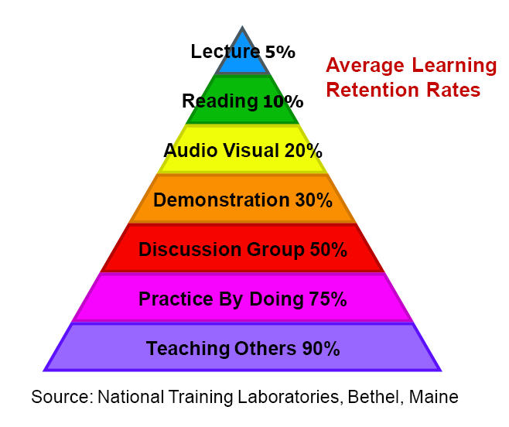

Slide 6
Teacher-centered Learning | Student-centered Learning
Low level of student choice | High level of student choice
Student passive | Student active
Power is primarily with teacher | Power primarily with the student

Slide 7
Examples of SCL methods
Outside of the lecture format | In the Lecture
Independent projects | Buzz groups (short discussion in twos)
Group discussion | Pyramids/snowballing (Buzz groups continuing the discussion into larger groups)
Peer mentoring of other students | Cross-overs (mixing students into groups by letter/number allocations)
Debates | Rounds (giving turns to individual students to talk)
Field-trips | Quizes
Practicals | Writing reflections on learning (3/4 minutes)
Reflective diaries, learning journals | Student class presentations
Computer assisted learning | Role play
Choice in subjects for study/projects | Poster presentations
Writing newspaper article | Students producing mind maps in class
Portfolio development

Slide 8
Assessment process and student-centered learning
Involving students at the stage when the task is set: | Choosing the assessment task Setting the assessment task Discussion the assessment criteria Setting the assessment criteria
Involving students at the stage after the task is completed: | Making self-assessment comments Making peer-assessment feedback comments Suggesting self-assessment grades/marks Negotiating self-assessment grades/marks Assigning self-assessment grades/marks Assigning peer-assessment grades/marks

Slide 9
Main challenges
motivation
individual learner
limited
resources
slower in their study

Slide 10
Teacher vs. Learner-Centered Instruction
Teacher-Centered | Learner-Centered
Focus is on instructor | Focus is on both students and instructor
Focus is on language forms and structures (what the instructor knows about the language) | Focus is on language use in typical situations (how students will use the language)
Instructor talks; students listen | Instructor models; students interact with instructor and one another
Students work alone | Students work in pairs, in groups, or alone depending on the purpose of the activity
Instructor monitors and corrects every student utterance | Students talk without constant instructor monitoring; instructor provides feedback/correction when questions arise
Instructor answers students’ questions about language | Students answer each other’s questions, using instructor as an information resource
Instructor chooses topics | Students have some choice of topics
Instructor evaluates student learning | Students evaluate their own learning; instructor also evaluates
Classroom is quiet | Classroom is often noisy and busy

Slide 11
Thank you for attention

